Slide 1
Lecture: 3

Slide 2
Categories of Networks
Networks are of two primary categories:
local-area networks and wide-area networks.
The category into which a network falls is determined by its size.
A LAN normally covers an area less than 2 mi; a WAN can be worldwide. Networks of a size in between are normally referred to as metropolitan area networks and span tens of miles.

Slide 3
Local Area Network
A local area network (LAN) is usually privately owned and links the devices in a single
office, building, or campus. Depending on the needs of an organization and the type of technology used, a LAN can be as simple as two PCs and a printer in someone's home office; or it can extend throughout a company and include audio and video peripherals. Currently, LAN size is limited to a few kilometres.

Slide 4
LANs are designed to allow resources to be shared between personal computers or
workstations.
The resources to be shared can include hardware (e.g., a printer), software (e.g., an application program), or data.
A common example of a LAN, found in many business environments, links a workgroup of task-related computers, for example, engineering workstations or accounting PCs.

Slide 5
One of the computers may be given a large capacity disk drive and may become a server to clients. Software can be stored on this central server and used as needed by the whole group.
In addition to size, LANs are distinguished from other types of networks by their transmission media and topology.
In general, a given LAN will use only one type of transmission medium. The most common LAN topologies are bus, ring, and star.

Slide 6
Ethernet
Ethernet is the most popular LAN technology
- large installed base (500 million Ethernet nodes)
- more than 95% of LAN traffic is Ethernet based

Slide 7
• Ethernet supports 10 Mb/s, 100 Mb/s (Fast Ethernet), 1 Gb/s (Gigabit Ethernet) and 400 Gb/s (400GbE)
• Ethernet standardized by IEEE (802.3 standard series)
• Widespread popularity
The Institute of Electrical and Electronics Engineers Standards Association (IEEE-SA) is an Operating Unit within IEEE that develops global standards in a broad range of industries, including: power and energy, consumer technology and consumer electronics, biomedical and health care, learning technology, information technology and robotics, telecommunication and home automation, transportation, nanotechnology, information assurance, and many more.
IEEE-SA has developed standards for over a century, through a program that offers balance, openness, fair procedures, and consensus. Technical experts from all over the world participate in the development of IEEE standards.

Slide 8
- Specifications and rights to build and install Ethernet made easily available to everyone
- Design goals: create a simple network topology with efficient shared resources, easy to configure and maintain, compatible across many manufacturers and systems
- Ethernet is competitively priced

Slide 9
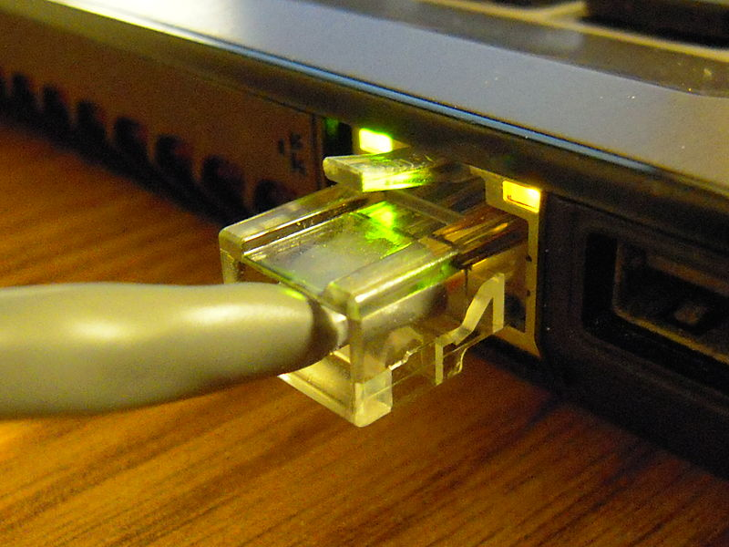
A Cat 5e connection on a laptop, used for Ethernet

Slide 10
Category 5 cable (Cat 5) is a twisted pair cable for carrying signals. This type of cable is used in structured cabling for computer networks such as Ethernet.
Category 5 has been superseded by the Category 5e (enhanced) specification.

Slide 11
Wide Area Network
A wide area network (WAN) provides long-distance transmission of data, image, audio,
and video information over large geographic areas that may comprise a country, a continent, or even the whole world.

Slide 12
A WAN can be as complex as the backbones that connect the Internet or as simple as a dial-up line that connects a home computer to the Internet.
We normally refer to the first as a switched WAN and to the second as a point-to-point WAN.

Slide 13
Switched WAN
The switched WAN connects the end systems, which usually comprise a router (internetworking connecting device) that connects to another LAN or WAN.

Slide 14
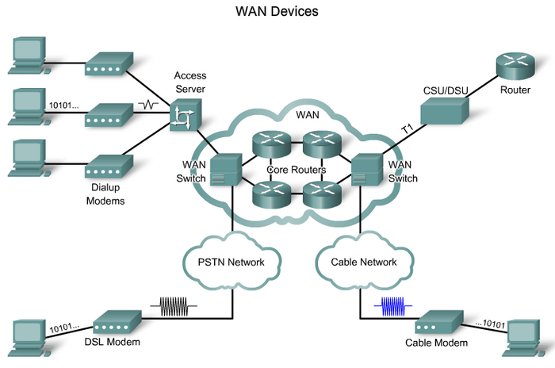
Switched WAN

Slide 15
The point-to-point WAN is normally a line leased from a telephone or cable TV provider that connects a home computer or a small LAN to an Internet service provider (lSP). This type of WAN is often used to provide Internet access.

Slide 16

Point-to-point WAN

Slide 17
Metropolitan Area Networks
A metropolitan area network (MAN) is a network with a size between a LAN and a WAN. It normally covers the area inside a town or a city. It is designed for customers who need a high-speed connectivity, normally to the Internet, and have endpoints spread over a city or part of city.
A good example of a MAN is the part of the telephone company network that can provide a high-speed DSL line to the customer. Another example is the cable TV network that originally was designed for cable TV, but today can also be used for high-speed data connection to the Internet.

Slide 18
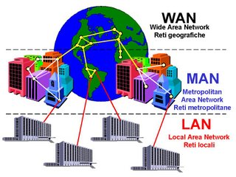

Slide 19
Interconnection of Networks: Internetwork
Today, it is very rare to see a LAN, a MAN, or a WAN in isolation; they are connected to one another.
When two or more networks are connected, they become an internetwork, or internet.

Slide 20
Comparing WAN Vs. LAN Vs. MAN
WAN | LAN | MAN
Wide Area Network | Local Area Network | Metropolitan Area Network
A WAN will typically cover a larger area geographically, such as a continent, a state or a country. | A LAN connects computers within a small and specific area geographically. | A MAN is confined to a specific town, city or region. It covers a larger area than a LAN but a smaller area than a WAN.
For data transfer, there is low bandwidth. | For data transfer, there is high bandwidth. | For data transfer, there is a moderate bandwidth.
It will typically have a distributed ownership model. | It is typically owned by an individual or an organization. | It can be owned publicly or privately.
A WAN network will have a larger coverage area that can range up to 100,000 KM and in some cases, stretches globally or over international borders. | A LAN network is limited to between 100-1000 meters coverage. | A MAN network is will usually stretch up to an area of 100 KM.
It costs more to set-up a WAN than a LAN or a MAN. | It has a low cost of set-up. | It has a moderate cost of set-up.
With a WAN, you can get lower speeds of data transfer of 10-20 Mbps. | With a LAN, you can get higher speeds of data transfer with 10/100/1000 Mbps Ethernet (high speed). | With a MAN, you can get speeds of data transfer up to 100 Mbps.

